Slide 1
About Me
Ritesh Singh
Sun Certified java Professional
Oracle Certified Database Administrator
Certified Ethical Hacker
Certified EC-Council Instructor (CEI)

Slide 2
Course Overview
Introduction to SQL ROLLUP

Slide 3
Introduction to SQL ROLLUP
The ROLLUP is an extension of the GROUP BY clause. The ROLLUP option allows you to include extra rows that represent the subtotals, which are commonly referred to as super-aggregate rows, along with the grand total row. By using the ROLLUP option, you can use a single query to generate multiple grouping sets.

Slide 4
Note that a grouping set is a set of columns by which you group. For example, a query that returns the inventory by the warehouse, the grouping set is (warehouse).
SELECT
warehouse,
SUM (quantity) qty
FROM
inventory
GROUP BY
warehouse;

Slide 5
The following illustrates the basic syntax of the SQL ROLLUP:
SELECT
c1, c2, aggregate_function(c3)
FROM
table
GROUP BY ROLLUP (c1, c2);

Slide 6
The ROLLUP assumes a hierarchy among the input columns. For example, if the input column is (c1,c2), the hierarchy c1 > c2. The ROLLUP generates all grouping sets that make sense considering this hierarchy. This is why we often use ROLLUP to generate the subtotals and the grand total for reporting purposes.
In the syntax above, ROLLUP(c1,c2) generates three following grouping sets:
(c1,c2)
(c1)
()

Slide 7
This syntax is supported by Oracle, Microsoft SQL Server, and PostgreSQL. However, MySQL has a slightly different syntax as shown below:
SELECT
c1, c2, aggregate_function(c3)
FROM
table_name
GROUP BY c1, c2 WITH ROLLUP;

Slide 8
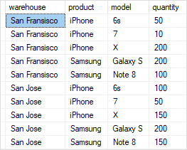
QL ROLLUP examples
We will use the inventory table that we set up in the GROUPING SETS tutorial for the demonstration.

Slide 9

SQL ROLLUP with one column example
The following statement uses the GROUP BY clause and the SUM() function to find the total inventory by warehouse:
SELECT warehouse, SUM(quantity) FROM inventory GROUP BY warehouse;

Slide 10
To retrieve the total products in all warehouses, you add the ROLLUP to the GROUP BY clause as follows:
SELECT
warehouse, SUM(quantity)
FROM
inventory
GROUP BY ROLLUP (warehouse);

Slide 11


Slide 12
As you can see in the result, the NULL value in the warehouse column specifies the grand total super-aggregate line. In this example, the ROLLUP option causes the query to produce another row that shows the total products in all warehouses.
To make the output more readable, you can use the COALESCE() function to substitute the NULL value by the All warehouses as follows:

Slide 13

ELECT
COALESCE(warehouse, 'All warehouses') AS warehouse,
SUM(quantity)
FROM
inventory
GROUP BY ROLLUP (warehouse);

Slide 14
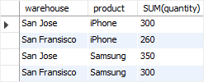
SQL ROLLUP with multiple columns example
The following statement calculates the inventory by warehouse and product:
SELECT warehouse, product, SUM(quantity) FROM inventory GROUP BY warehouse, product;

Slide 15
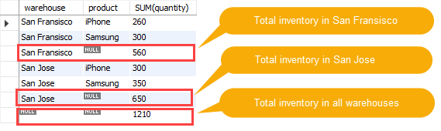
Let’s add the ROLLUP to the GROUP BY clause:
SELECT
warehouse, product, SUM(quantity)
FROM
inventory
GROUP BY ROLLUP (warehouse , product);

Slide 16
Note that the output consists of summary information at two levels of analysis, not just one:
Following each set of product rows for a specified warehouse, an extra summary row appears displaying the total inventory. In these rows, values in the productcolumn set to NULL.
Following all rows, an extra summary row appears showing the total inventory of all warehouses and products. In these rows, the values in the warehouse and product columns set to NULL.

Slide 17
SQL ROLLUP with partial rollup example
You can use ROLLUP to perform a partial roll-up that reduces the number of subtotals calculated as shown in the following example:

Slide 18
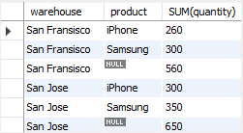
SELECT
warehouse, product, SUM(quantity)
FROM
inventory
GROUP BY warehouse, ROLLUP (product);

Slide 19
Thank You
Please Subscribe My Channel
https://www.youtube.com/channel/UCYW3PWPOPn3qgxxjhUbXXXg?view_as=subscriber

